Slide 1
Preliminary maltose/trehalose/maltotriose computational results
Jerelle/Jonathan Sugar Transporter Project
Virginia Jiang
2024/06/05

Slide 2
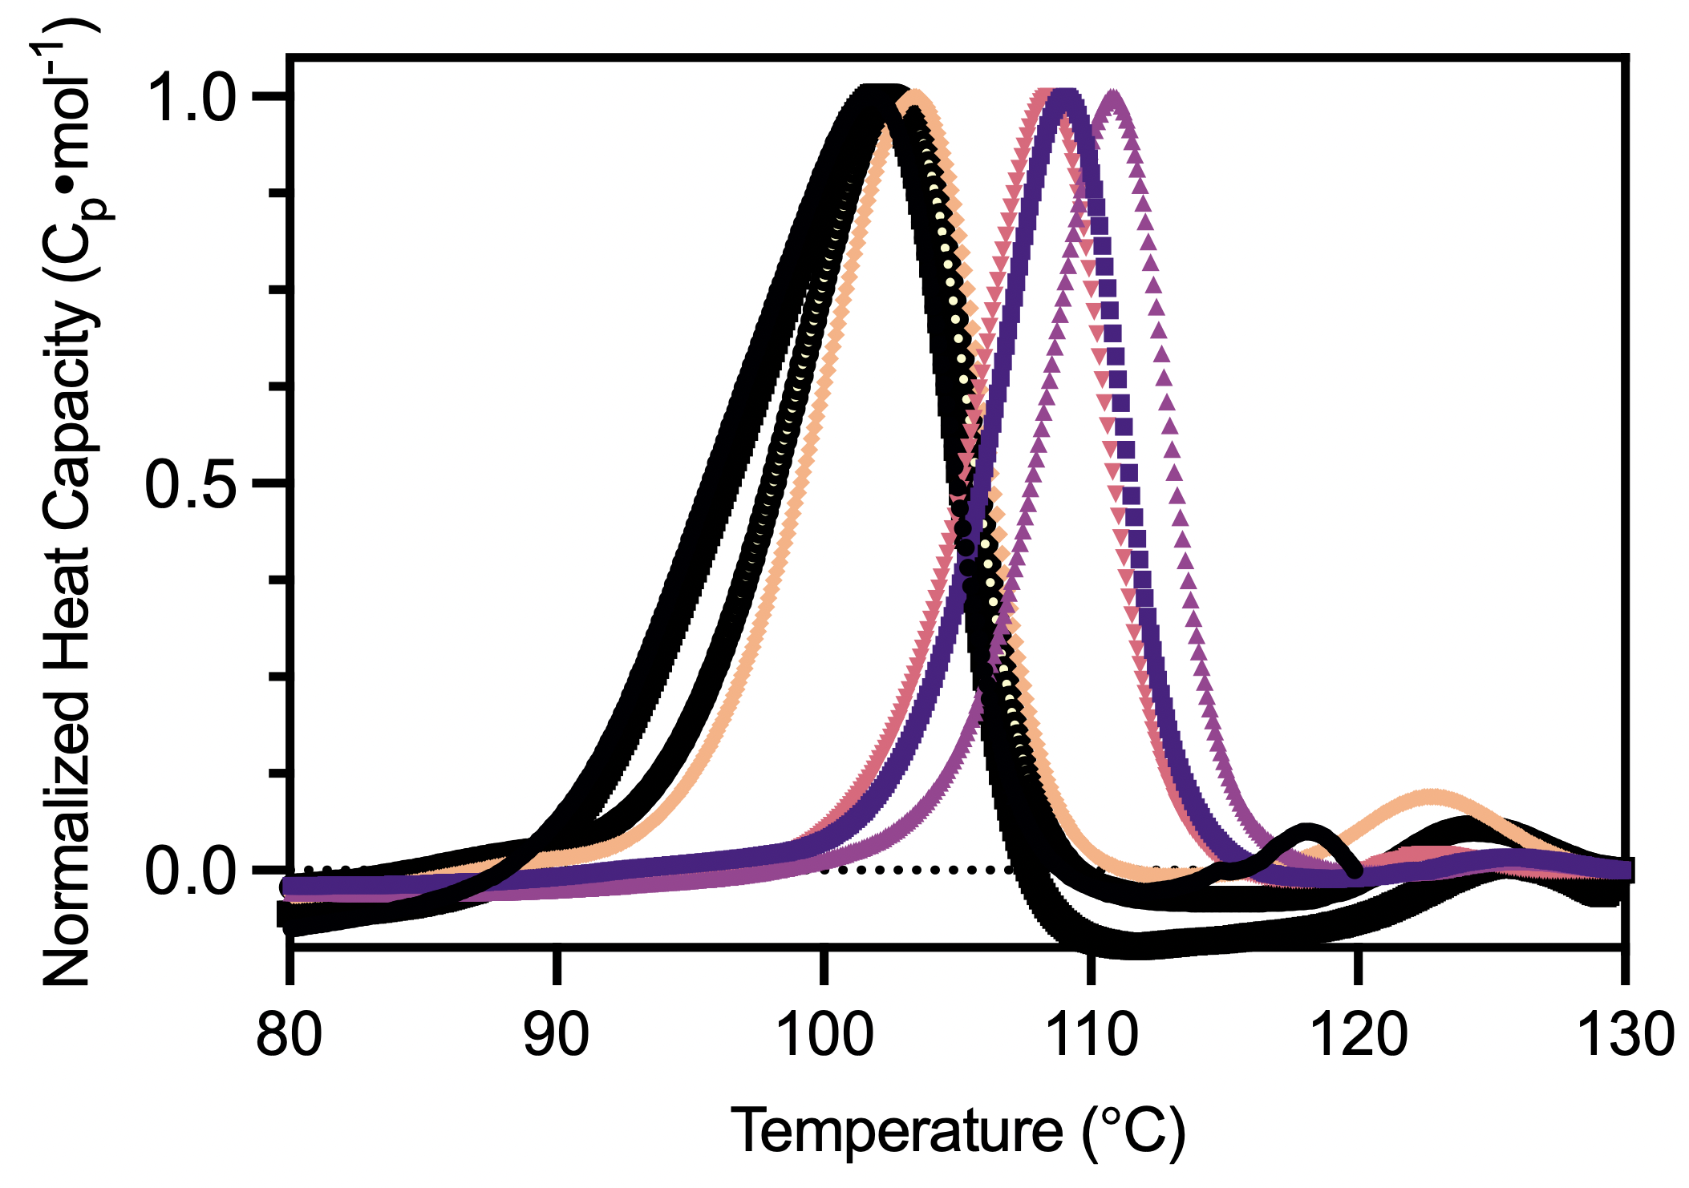
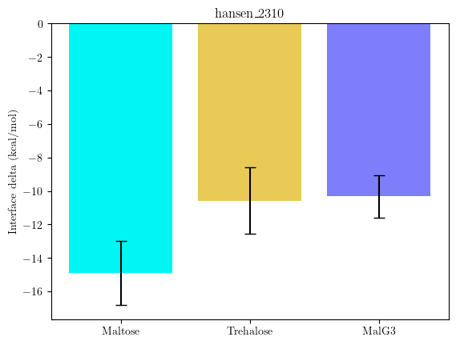
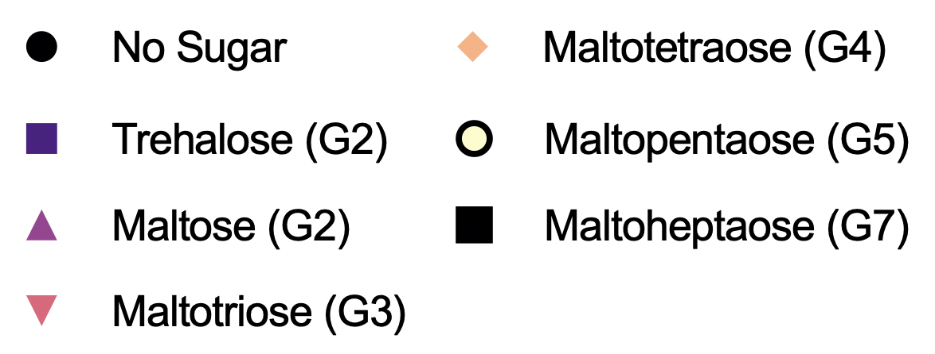
Prior work: AlphaFold => RosettaLigand correctly predicts trend for Athe-2310

Slide 3
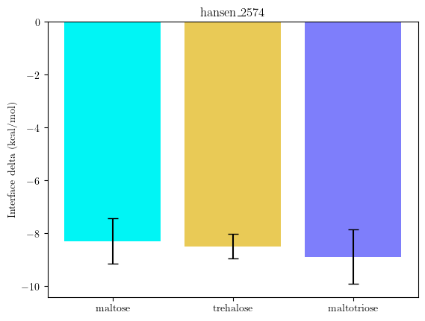
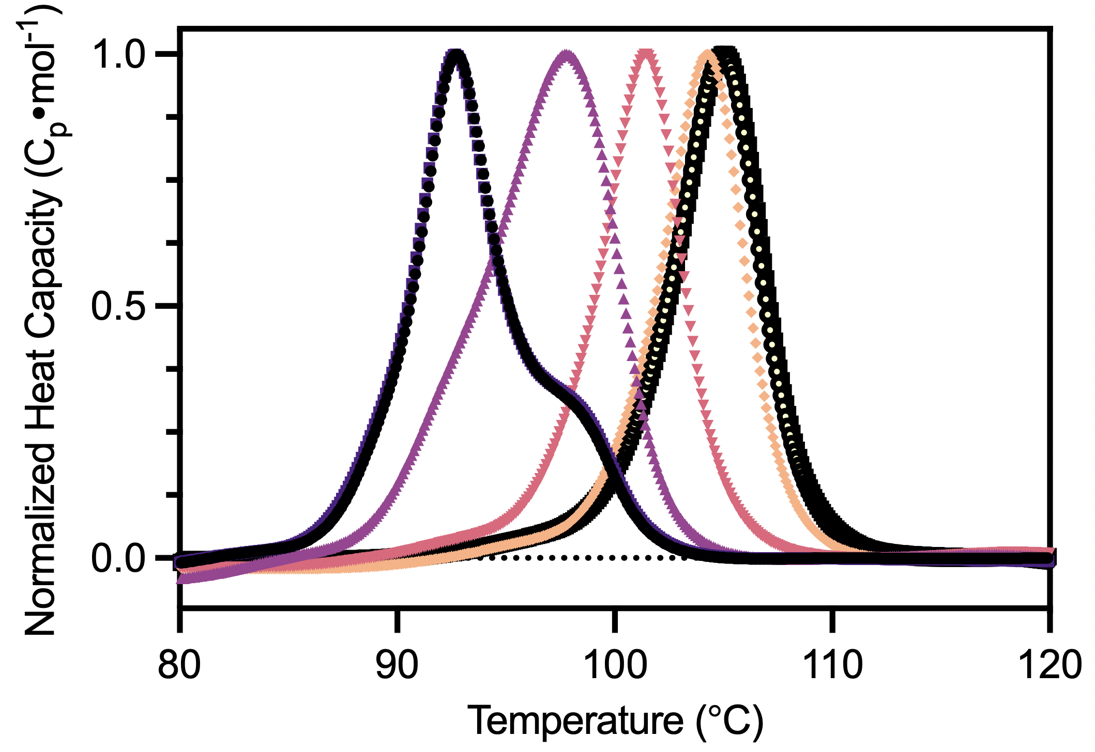
Prior work: AlphaFold => RosettaLigand incorrectly predicts trend for Athe-2574
Increasing maltodextrin length
As small sugar binding is correctly resolved, the problem likely arises from large-scale pocket dynamics, meaning that there’s an issue in the protein main chain model

Slide 4
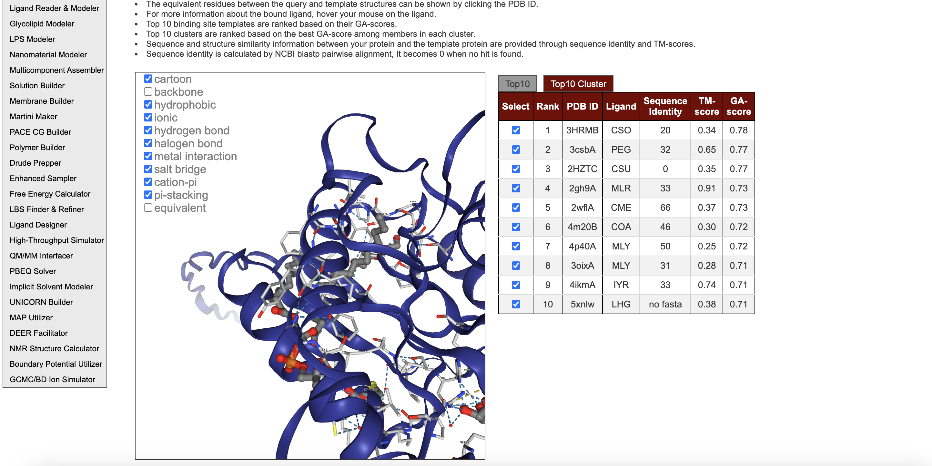
Most pockets in CHARMM IFD not the known binding mode for sugar transporters
Solution: add some hacks to AlphaFold to generate an ensemble of poses

Slide 5
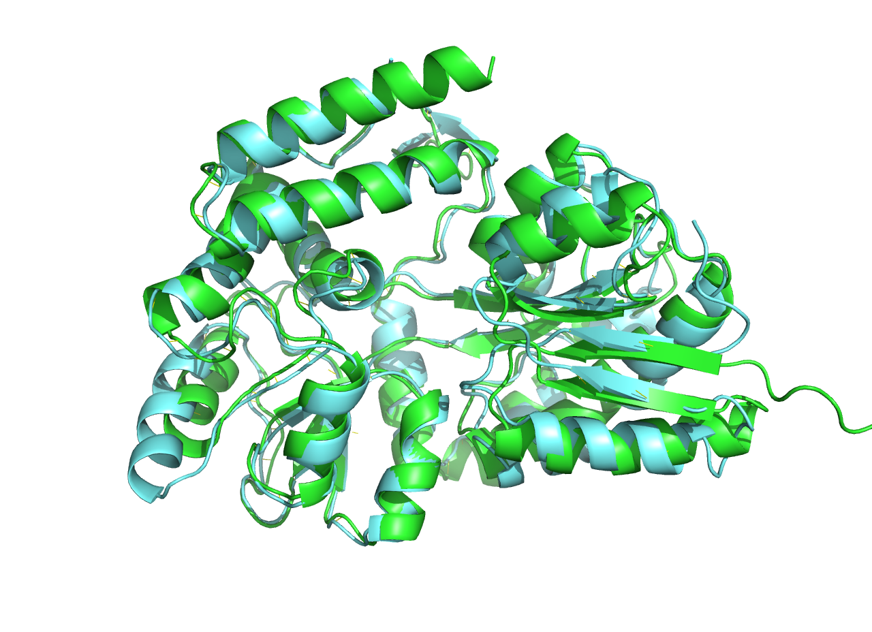
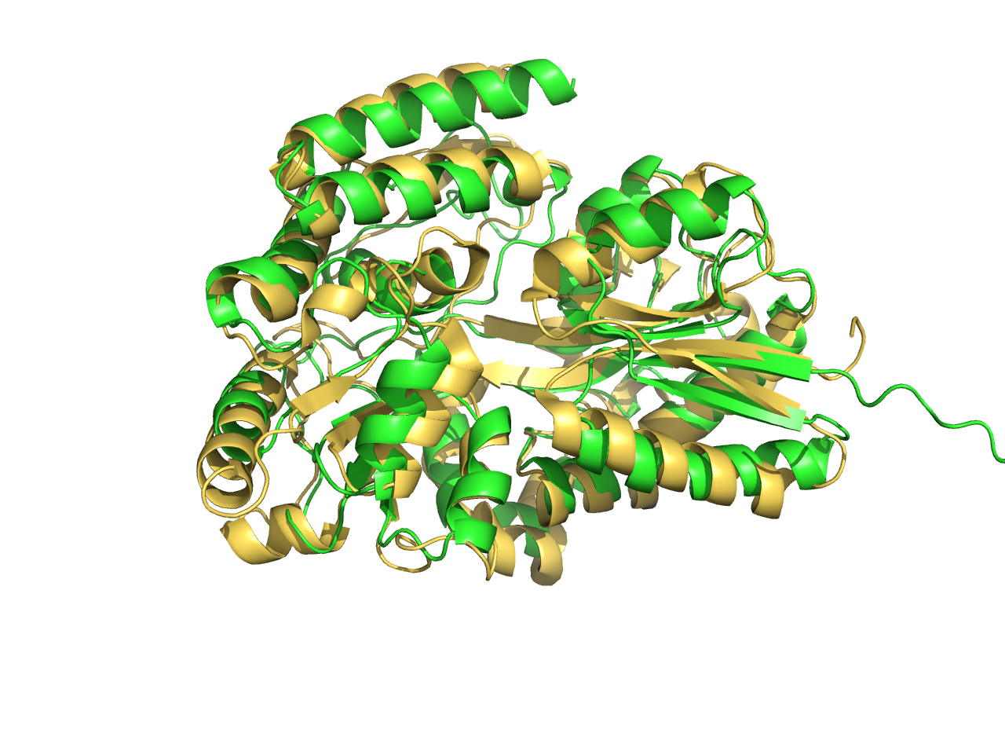
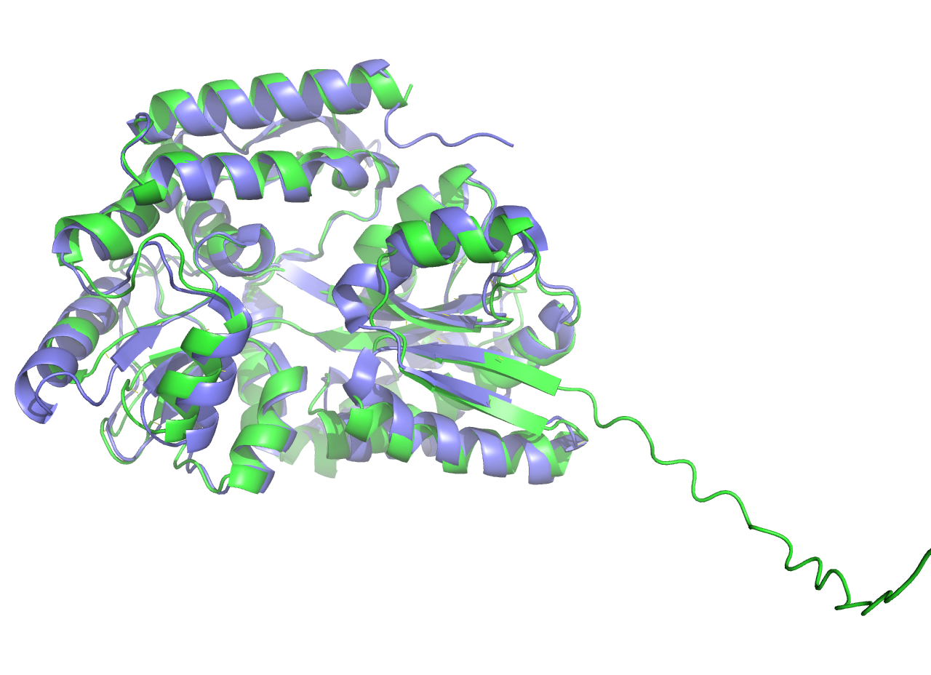
Alphafold is substrate-naive
Long helix
Helix bent up
Bendy helix conserved for maltotetrose and beyond
1URG (maltose binding protein,
Alicyclobacillus acidocaldarius)
~60 crystalized MBPs with maltose
1EU8 (trehalose binding protein,
Thermococcus littoralis)
1 crystalized MBP with trehalose
2FNC (maltotriose binding protein,
Thermotoga maritima)
~5 crystalized MBP with maltotriose
Notes:
Pocket volume 10.1093/nar/gkae415.
Write aim, hopefully predictive?
Put in preliminary data
Maltose binding protein family
Filtered msa into alphafold

Slide 6
General workflow
Generate AF2 models
Find homologous structures with correct subsites and use as templates
Minimize model
Minimize energetics of AF2 models using Rosetta relax protocol
Dock ligands
Perform fully flexible optimization of ligand/subsites in RosettaLigand
Bespoke, knowledge-based version of AFsample2

Slide 7
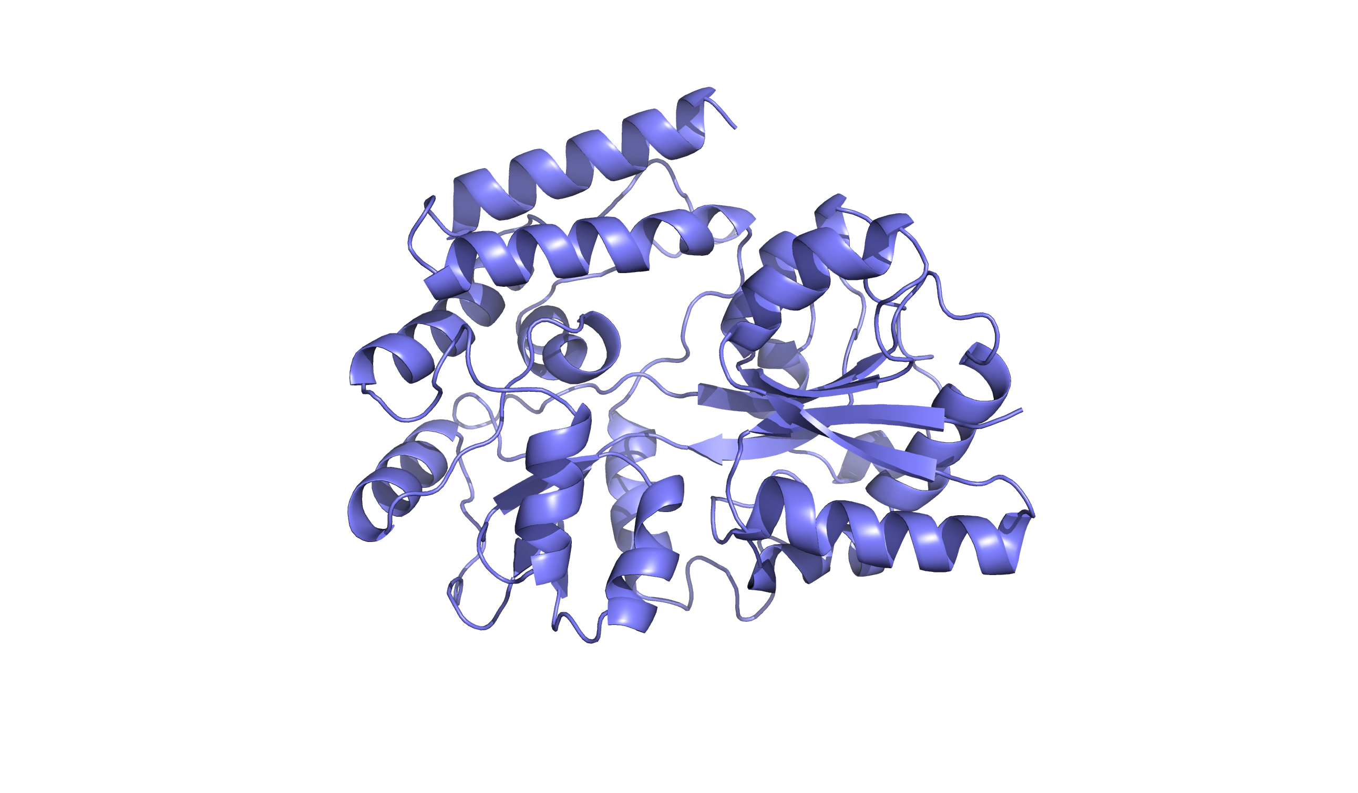
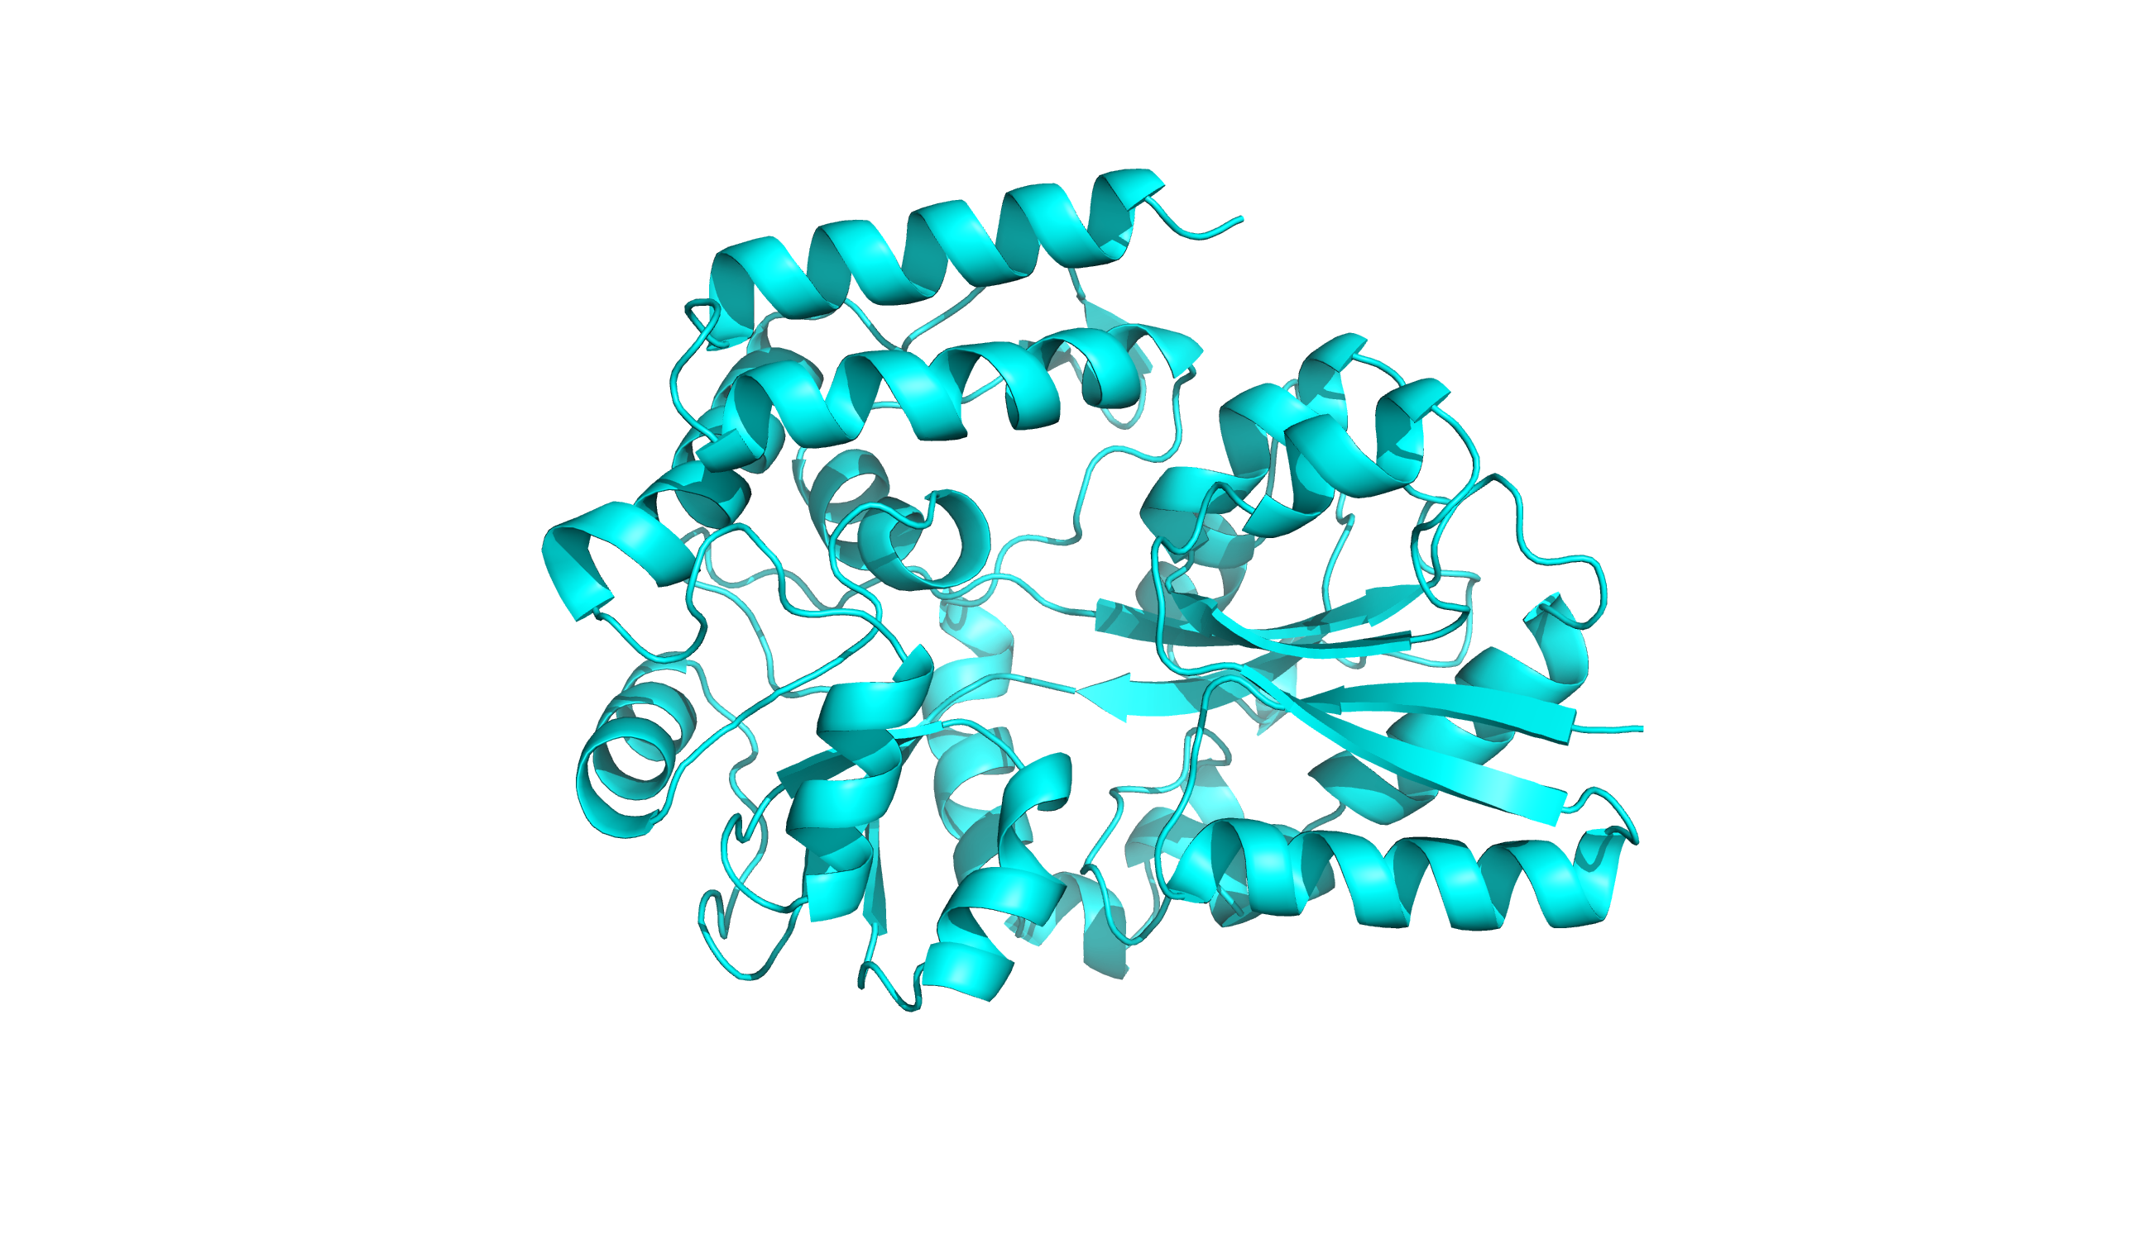
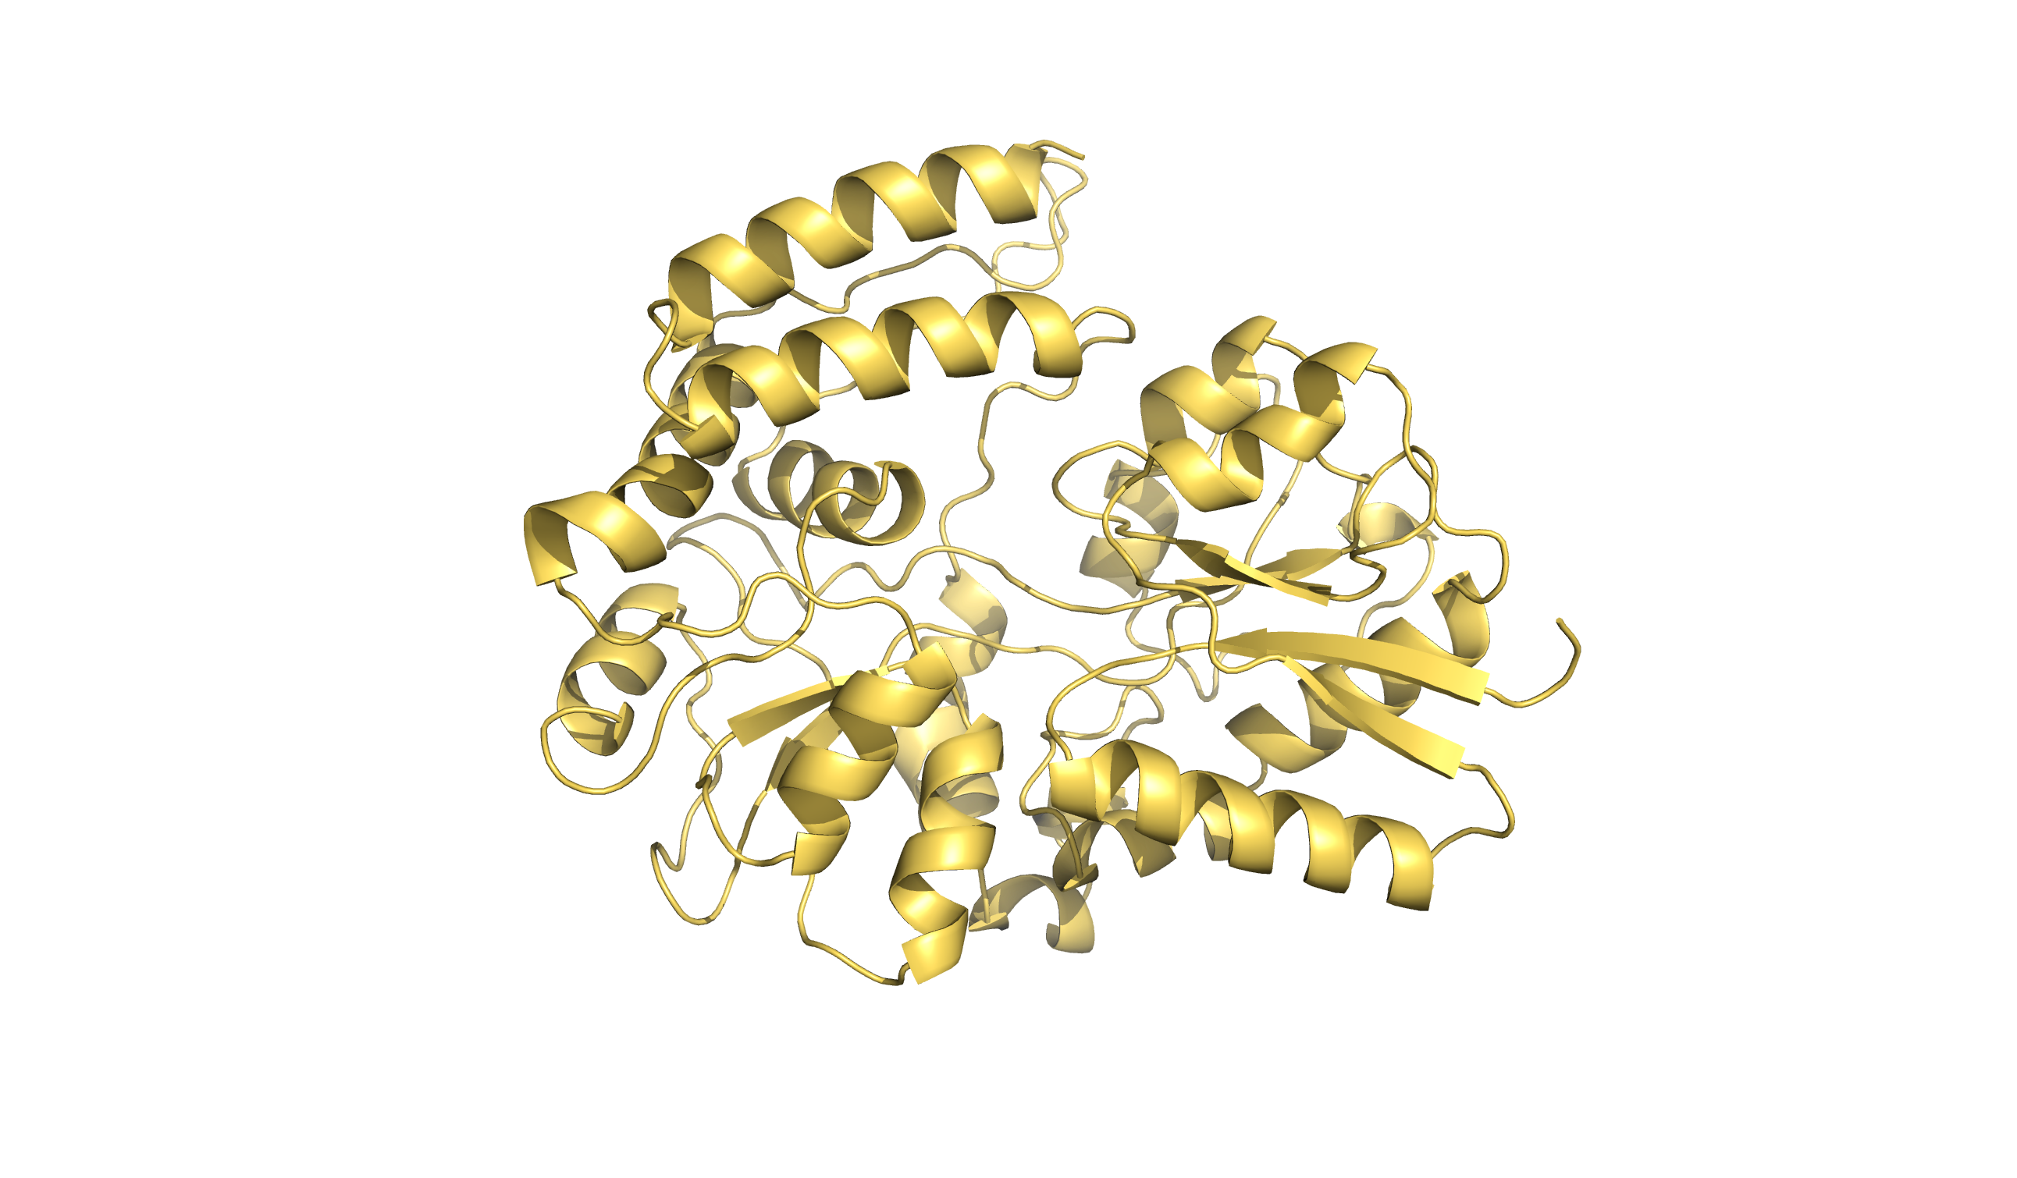
Using crystalized structures with ligands as templates to generate ensemble of structures
Induced-fit docking protocol where both protein pocket and ligand have flexibility, informed by homology
Just maltose
caRMSD to AF: 1.012A
Just trehalose
caRMSD to AF: 1.335A
Just maltotriose
caRMSD to AF: 2.195A

Slide 8
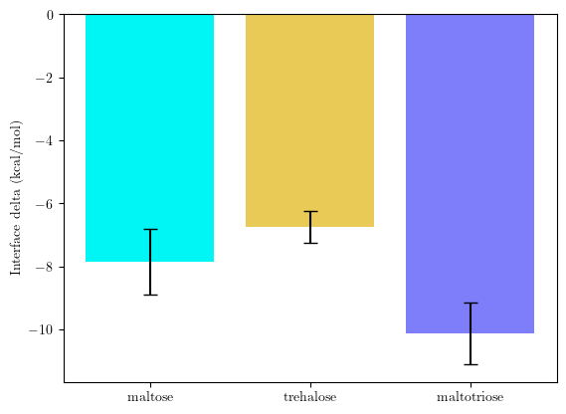
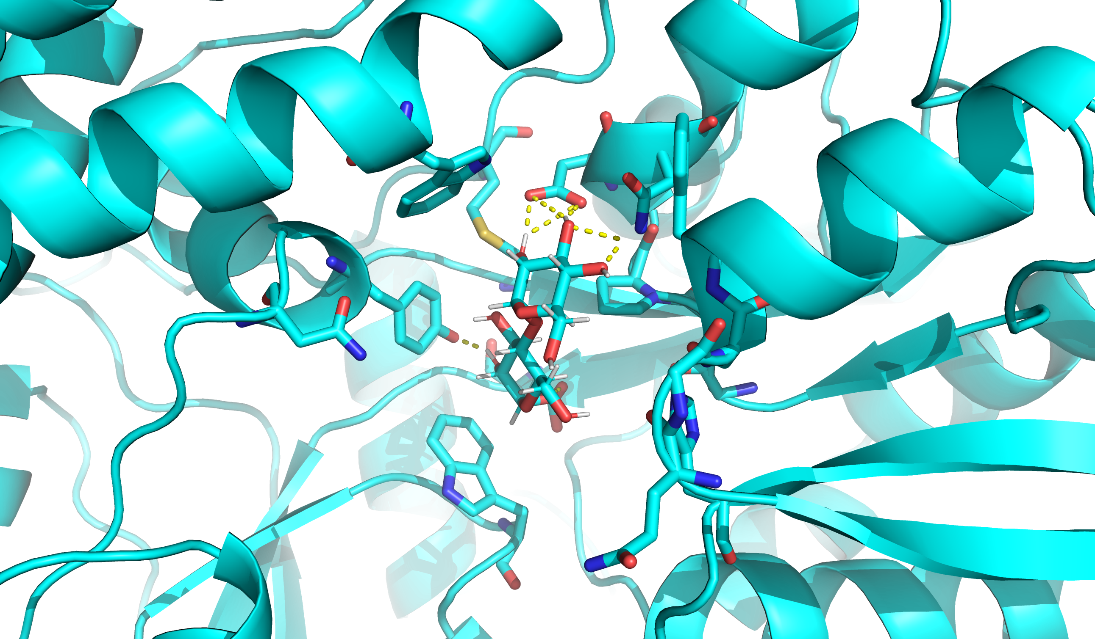
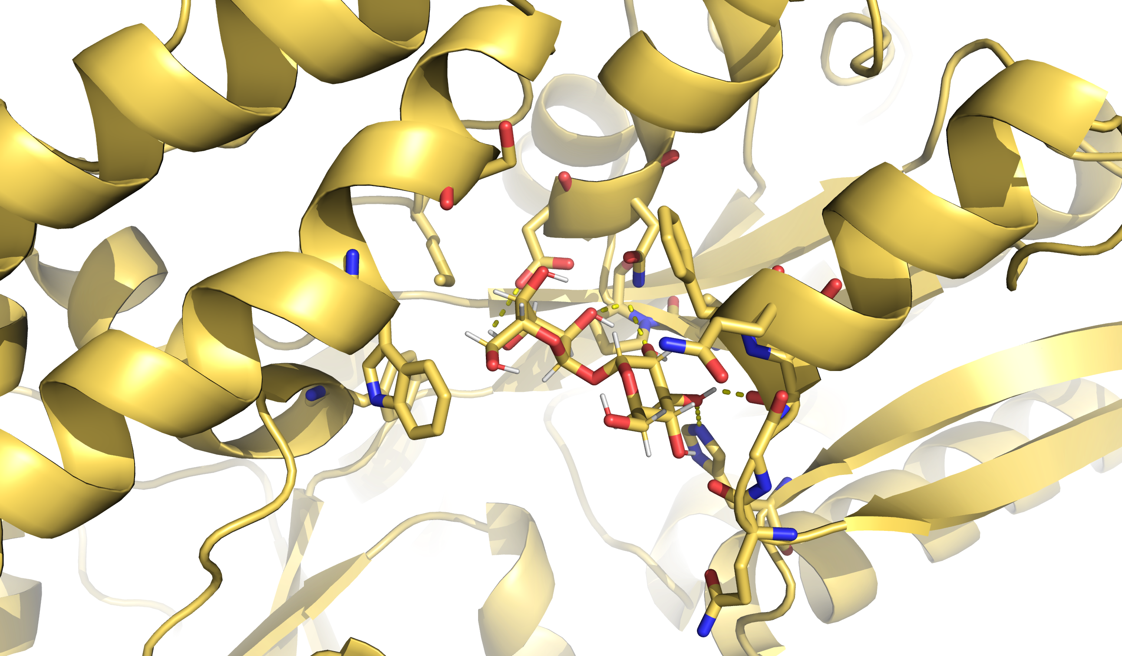
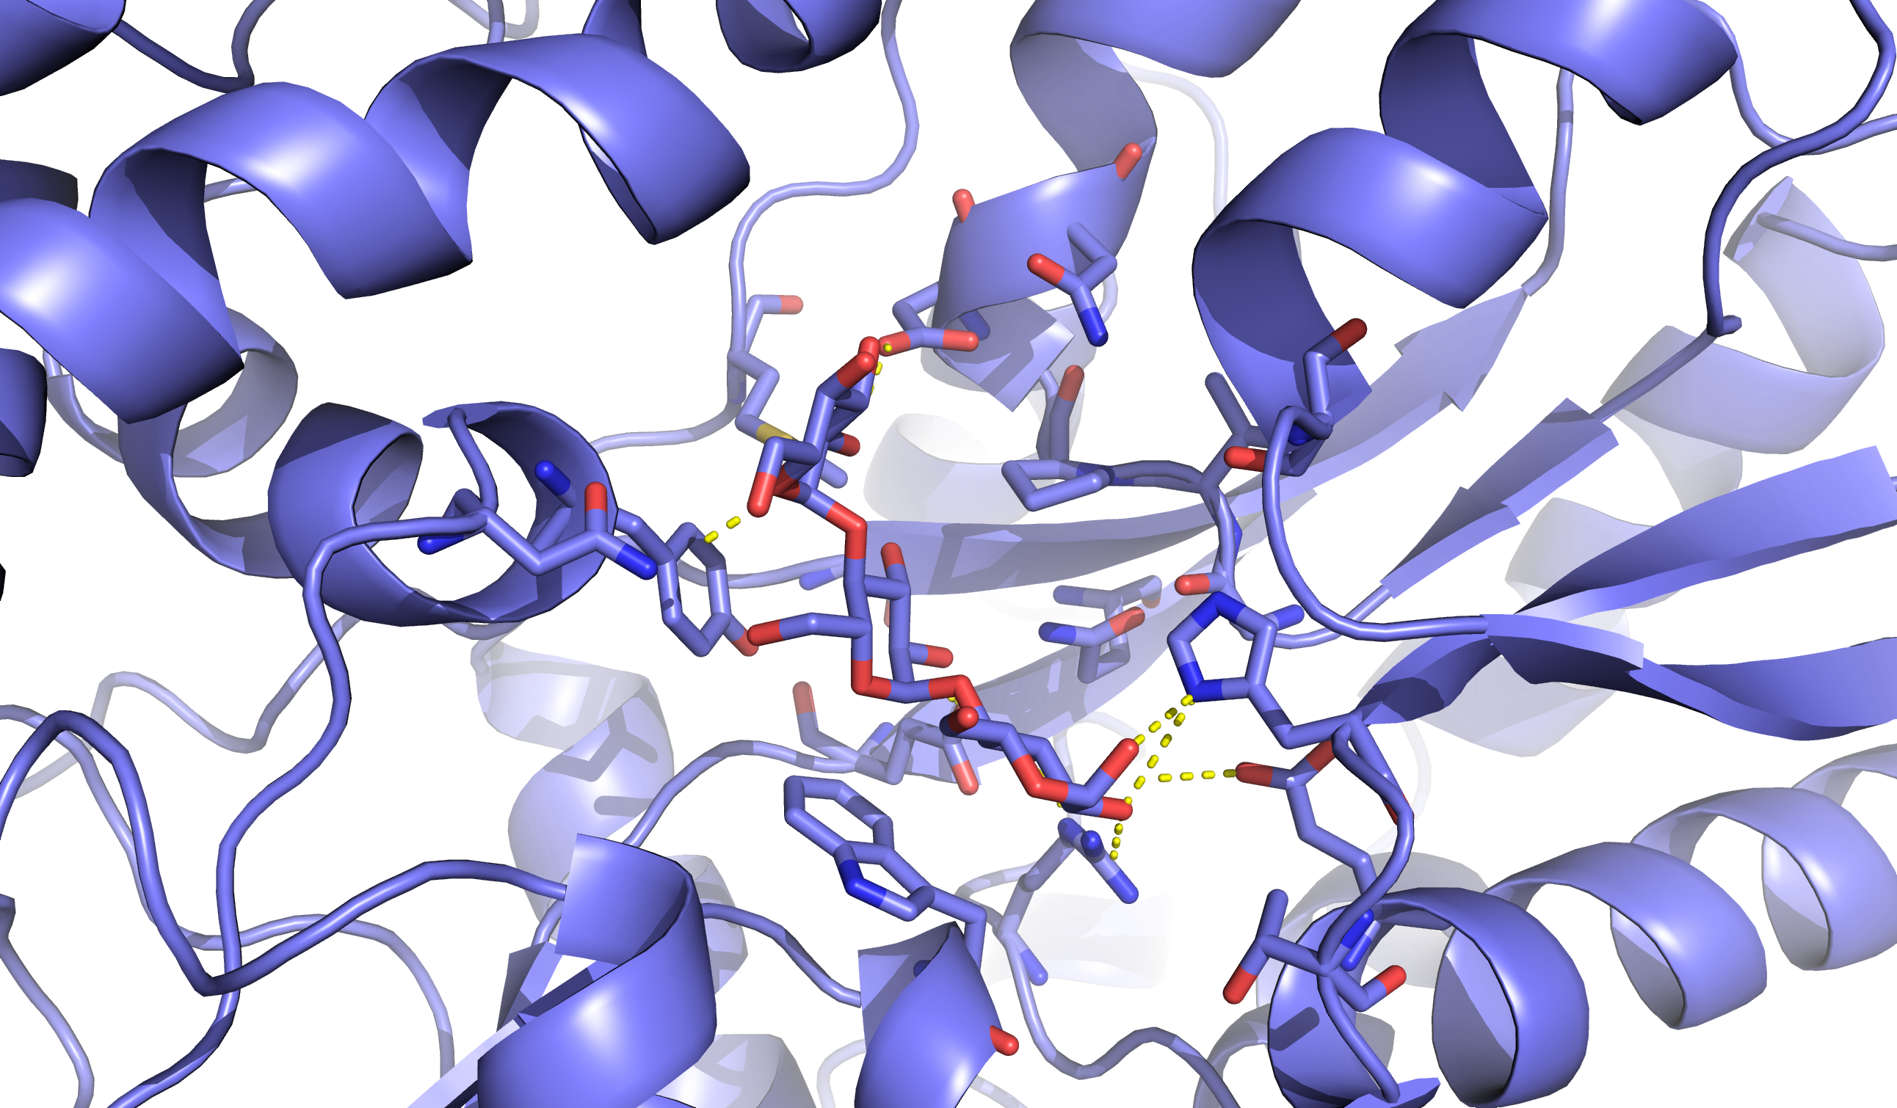
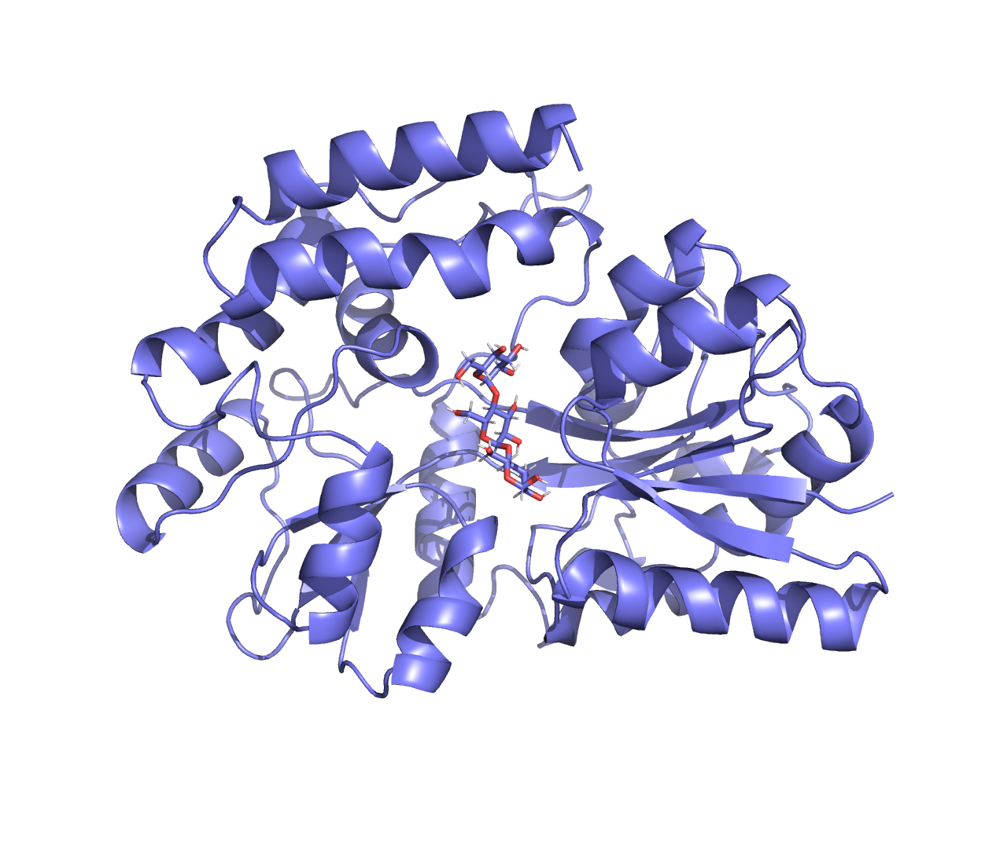
Use structure from maltotriose template as input for flexible ligand docking
Workflow now has same rank-ordering as ITC experiments
Notes:
Site A: H23, E28, R306, W238
Site B: E124, Y162, F163, Q271
Site C: N160, P76, D78, W348, M338

Slide 9
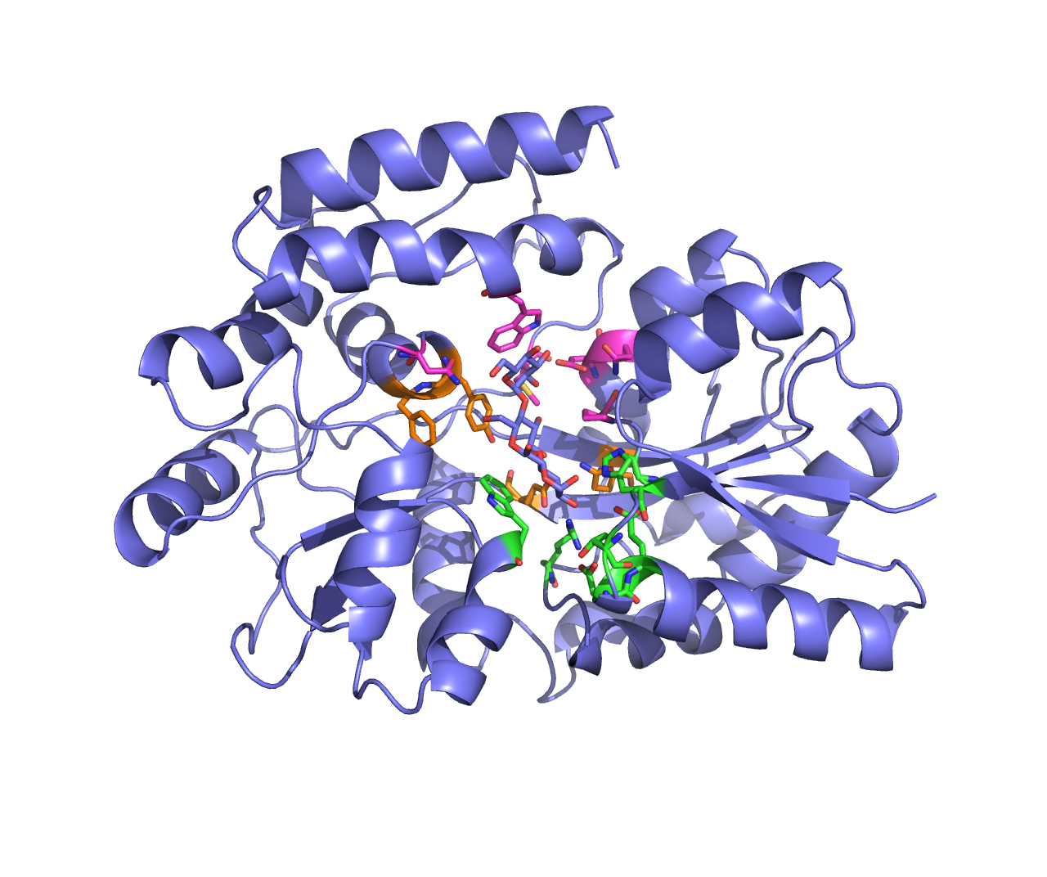
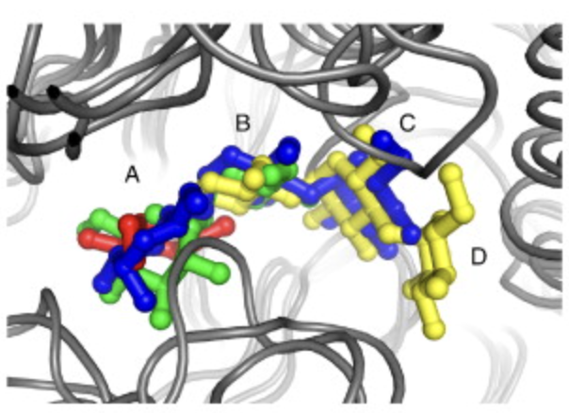
Identified maltotriose binding site shows same subsite interactions as previously reported
Subsite A
Subsite B
Subsite C
Cuneo et.al (2009) JBC
Maltotriose
Notes:
https://www.sciencedirect.com/science/article/pii/S0022283609004227?via%3Dihub

Slide 10
Ideas for an aim
Build model for filtering MSAs based on primary sequence characteristics to prospectively predict sugar binding
Subsite design to rationally modify selectivity for different sugar sizes and linkages
Notes:
Retrospective explanation of mechanistic interactions
Prospective model of what ligand can bind which sugar
Changes to active site => what new ligands will bind
Aim1: understand binding
Figure out which transporters bind which sugars
Mostly experiments
Aim2: predicted binding
Prediction of new sugar binding sites from computation
Make different binding sites + modulations to subsite
Predictions of binding across limited size library
Transcriptomics?
Aim3: create new strains
Use results from Aim1 to figure out what to delete
Sugar transporter to membrane domain (very far future)

